Slide 1
A Real-Time, Resolution-Agnostic AI Framework for Enhanced Glioma Detection and Segmentation
Project Supervisor: Mr. N. Srinivasa Rao Sr. Assistant Professor
Batch No: 19
Team Members:
CH. Yaswanth (22761A0511)
K. Hariprasad (22761A0524)
K. Giridhara Venkata Krishna Sai (23765A0502)

Slide 2
Table of Contents
Abstract
Introduction
Existing system
Drawbacks
Literature Survey
Proposed solution
Model Architecture
Dataset
Preprocessing
Results
Conclusion

Slide 3
Abstract
Glioma detection remains a critical challenge in medical imaging due to its reliance on manual interpretation of Magnetic Resonance Imaging (MRI) scans, a process that is both time-intensive and prone to human error. To address this issue, we propose a real-time, resolution-agnostic framework designed for rapid and reliable glioma detection. The system integrates a modified VGG-16 backbone with parallel convolutional modules for enhanced feature extraction, a YOLO-based detection head for efficient tumor localization, and an improved HDSA segmentation head for precise boundary delineation. Furthermore, we introduce a novel Resolution Agnostic Loss (RAL) function to ensure consistent performance across varying scan resolutions. Experimental evaluation on the BraTS dataset demonstrates that the proposed framework achieves high precision while maintaining computational efficiency, highlighting its potential to support clinicians in accelerating diagnostic workflows without compromising accuracy.

Slide 4
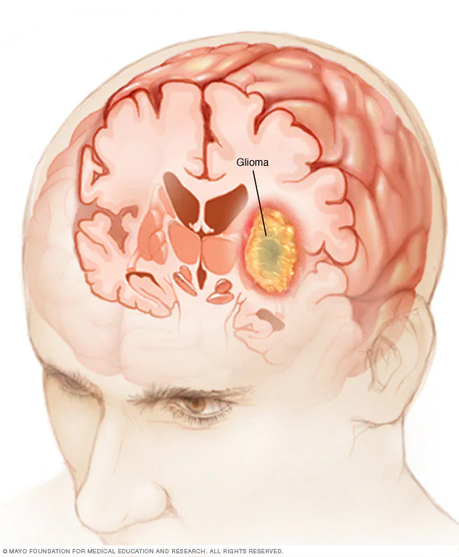
What is a Glioma???
A glioma is a tumor that forms when your body’s glial cells grow out of control.
Glial cells support your nerves and help your central nervous system work.
When these cells grow uncontrollably, they can form tumors in your brain or spinal cord.
Gliomas are primary tumors. This means they form directly in your brain or spinal cord. They’re serious tumors that can be life-threatening. But treatments are available to help manage the disease.

Slide 5
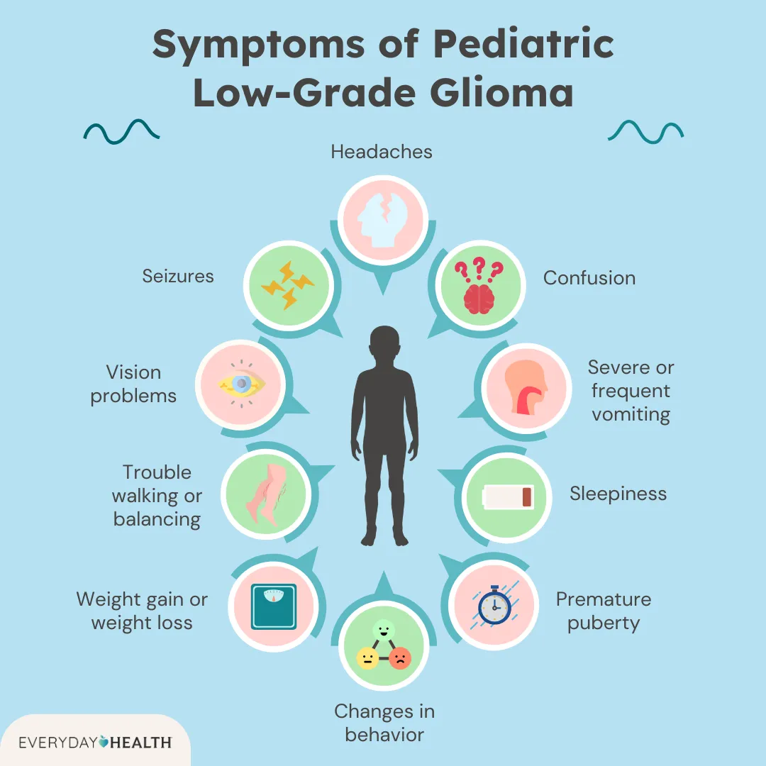
Symptoms of glioma
Changes in your vision or sudden vision loss
Difficulty walking or keeping your balance
Dizziness
Headaches
Nausea and vomiting
New depression or anxiety
Personality changes or sudden mood swings
Seizures
Trouble speaking or communicating (aphasia)
Trouble thinking, learning or remembering (cognitive problems)
Weakness or numbness on one side of your body (hemiparesis)

Slide 6
Identification and Challenges of Glioma
Identification
Challenges
Glioma is primarily identified using Magnetic Resonance Imaging (MRI) scans.
MRI provides detailed images of brain tissues and tumor structures.
Different MRI modalities such as T1, T2, FLAIR, and T1CE help analyze tumor characteristics.
Deep learning models can automatically detect and segment tumor regions from MRI images.
Tumor boundaries are irregular and difficult to distinguish from healthy tissues.
MRI may vary in resolution and image quality.
Manual analysis is time consuming and depends on radiologist expertise.
Tumors may appear in different sizes, shapes and locations.

Slide 7
Existing System
MRI Image-Based Analysis MRI scans are commonly used to detect brain tumors by analyzing brain tissue abnormalities. Radiologists manually examine MRI images to identify tumor regions.
CNN and Transfer Learning Models Deep learning models like CNN, VGG, and ResNet are used for automatic tumor detection. These models extract features from MRI images to classify tumor presence.
Segmentation-Based Architectures Models such as U-Net are used to segment tumor regions in MRI scans. They help identify the exact location and boundaries of tumors.
Explainability-Based Models Techniques like Grad-CAM and LIME help explain model predictions. They highlight important regions of MRI images used for tumor detection.

Slide 8
Limitations
Dependence on High-Resolution MRI Most models require high-quality MRI images for accurate tumor detection.
High Computational Cost Deep learning models like CNN and ResNet require powerful GPUs and long training time.
Lack of Real-Time Detection Many existing systems are slow and not suitable for real-time clinical use.
Poor Performance on Low-Quality Images Noise, low resolution, or variations in MRI scans can reduce model accuracy.
Limited Multi-Task Capability Some systems perform only classification and do not include tumor segmentation.

Slide 9
Literature Survey
Glioma/glioblastoma detection in brain MRI using pre-trained deep-learning scheme:
Dataset: Cancer Imaging Archive (TCIA) dataset
Model: VGG-16 with Decision Tree
Parallel deep CNN structure for glioma detection and classification via brain MRI images
Dataset: BraTS 2017
Model: Two parallel deep convolutional neural networks (PDCNNs)

Slide 10
Contd..
A CNN-model to classify low-grade and high-grade glioma from MRI images
Dataset: Brats-2017, Brats-2018, & Brats-2019
Model: A light weighted CNN model
An attention-guided CNN framework for segmentation and grading of glioma using 3D MRI scans
Dataset: BraTS 2019
Model: Attention-guided CNN framework for segmentation

Slide 11
Proposed System
To address these limitations, we propose a real-time, resolution-agnostic deep learning framework for glioma detection, segmentation and explainability using multimodal MRI images
The system uses a shared modified VGG-16 backbone with parallel convolutional modules for efficient feature extraction. The extracted features branch into three modules:
YOLOv10 head for tumor classification, designed to improve accuracy on low-resolution MRI images through adaptive feature fusion.
Enhanced HDSA segmentation head, which performs pixel-level tumor segmentation and incorporates density-based regularization to handle varying MRI resolutions.

Slide 12
Contd..
Grad-CAM++ explainability module, which highlights important tumor regions to improve interpretability of model predictions.
To reduce resolution dependency, we introduce a Resolution-Agnostic Loss (RAL) that dynamically balances classification and segmentation losses based on MRI image quality metrics. Additionally, redundant layers are pruned to reduce computational complexity by 30–40%, enabling faster processing.
The model is trained on an augmented BraTS dataset, including synthetically generated low-resolution MRI images to improve robustness. This enables real-time glioma detection, segmentation, and grading (LGG/HGG) using feature entropy, improving both accuracy and clinical applicability.

Slide 13
Model Architecture
Modified VGG-16 backbone feature extractor
Input Multimodal MRI
Preprocessing
Resolution Agnostic Loss
YOLO V10
HDSA
Output
Testing
GRAD-CAM++

Slide 14
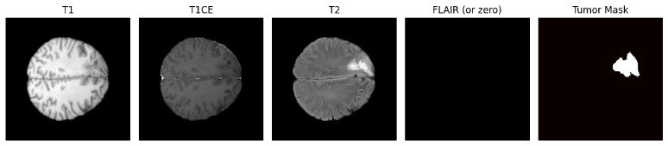
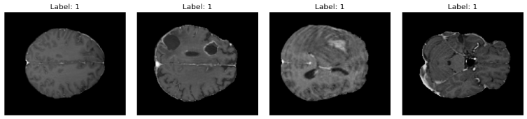
Dataset
The proposed model is trained and evaluated using the BraTS dataset, which is widely used for brain tumor analysis. The dataset contains multimodal MRI scans including T1, T2, FLAIR, and T1CE, providing detailed information about brain tissues and tumor regions. Each MRI scan includes expert-annotated tumor segmentation masks, which help train models for accurate tumor detection and segmentation. The dataset contains over 3000 MRI samples, and additional augmented samples are generated to improve model robustness. Low-resolution MRI variants are created to train the model to handle different image qualities and resolutions.

Slide 15
Preprocessing
Intensity Normalization
MRI scans collected from different machines may have varying intensity values. Intensity normalization rescales pixel values to a standard range, usually between 0 and 1. This helps maintain consistency across all images and improves model training stability.
Mean–Variance Standardization
Different MRI images may have variations in brightness and contrast. Mean–variance standardization adjusts the pixel intensity values using the mean and standard deviation of the image. This reduces intensity variation and ensures uniform data distribution.

Slide 16
Contd..
Feature Augmentation
To improve the model performance and its capabilities data augmentation technique is used by adding images through rotations or flipping or cropping
Guassian Smoothing
Gaussian smoothing, is a widely used effect in image processing to reduce image noise and detail. It is achieved by convolving an image with a Gaussian function, which results in a smooth blur resembling the effect of viewing the image through a translucent screen.

Slide 17
Results
BASELINE-CNN
Epochs | Performance Accuracy |  | Performance Loss
 | Training Accuracy | Validation Accuracy | Training Loss | Validation Loss
1 | 0.6587 | 0.56 | 0.6314 | 0.7161
2 | 0.6636 | 0.56 | 0.6118 | 0.7050
3 | 0.7974 | 0.60 | 0.4267 | 0.5973
4 | 0.8484 | 0.68 | 0.3571 | 0.5374
5 | 0.9185 | 0.84 | 0.2386 | 0.4231
6 | 0.9643 | 0.84 | 0.1774 | 0.4167
7 | 0.9719 | 0.84 | 0.1160 | 0.3754
8 | 0.9857 | 0.84 | 0.0698 | 0.4159
9 | 0.9785 | 0.84 | 0.0807 | 0.4006
10 | 0.9912 | 0.80 | 0.0388 | 0.4637
VGG-16
Epochs | Performance Accuracy |  | Performance Loss
 | Training Accuracy | Validation Accuracy | Training Loss | Validation Loss
1 | 0.637475 | 0.55 | 0.642475 | 0.678875
2 | 0.714275 | 0.67 | 0.531650 | 0.601000
3 | 0.746975 | 0.74 | 0.480125 | 0.543325
4 | 0.849375 | 0.84 | 0.372900 | 0.380075
5 | 0.869150 | 0.85 | 0.313300 | 0.337925
6 | 0.888275 | 0.88 | 0.290825 | 0.286575
7 | 0.924000 | 0.83 | 0.190250 | 0.401275
8 | 0.961325 | 0.92 | 0.135725 | 0.238600
9 | 0.954326 | 0.91 | 0.100498 | 0.235640
10 | 0.973325 | 0.92 | 0.080175 | 0.235550
11 | 0.973050 | 0.91 | 0.082400 | 0.225700
12 | 0.971175 | 0.92 | 0.091675 | 0.215725
13 | 0.971954 | 0.93 | 0.086382 | 0.217680
14 | 0.970950 | 0.94 | 0.075350 | 0.228250
15 | 0.982625 | 0.94 | 0.067850 | 0.224250
Table-I: Baseline CNN model performance across epochs
Table-II: VGG-16 model performance across epochs

Slide 18
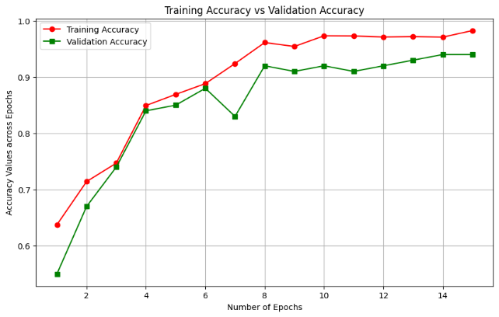
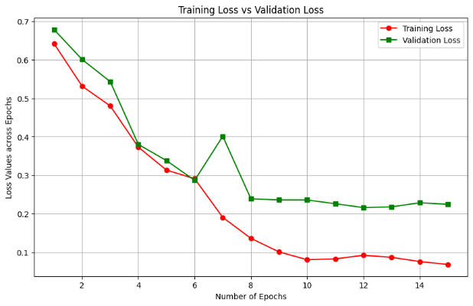
Graphs

Slide 19
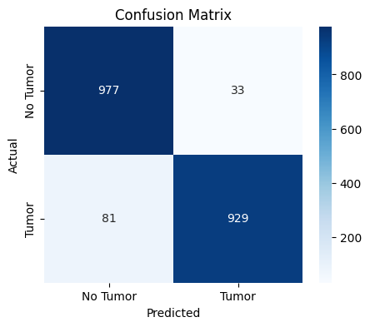
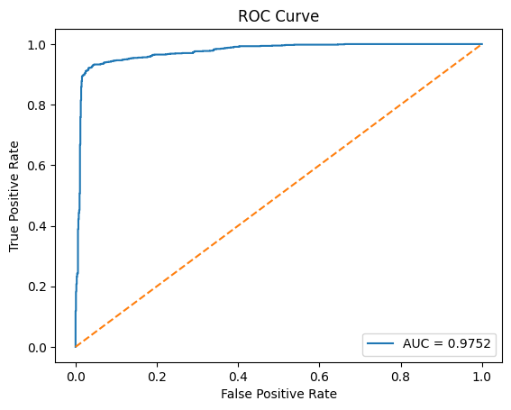
Contd..

Slide 20
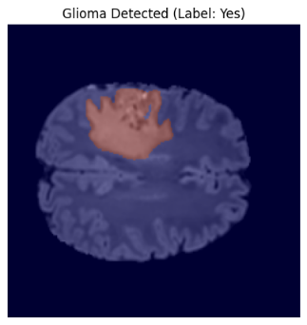
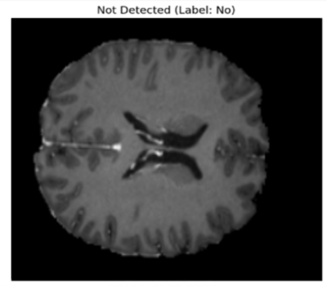
Output

Slide 21
Conclusion
The proposed framework provides an efficient approach for automatic glioma detection and segmentation using MRI images. By using a modified VGG-16 backbone with YOLOv10 and HDSA modules, the model performs both tumor classification and segmentation effectively. The introduction of Resolution-Agnostic Loss (RAL) improves performance across MRI images of different resolutions. Experimental results on the BraTS dataset show high accuracy and reliable tumor detection. This system can assist radiologists by enabling faster and more accurate brain tumor diagnosis.

Slide 22


